Slide 1
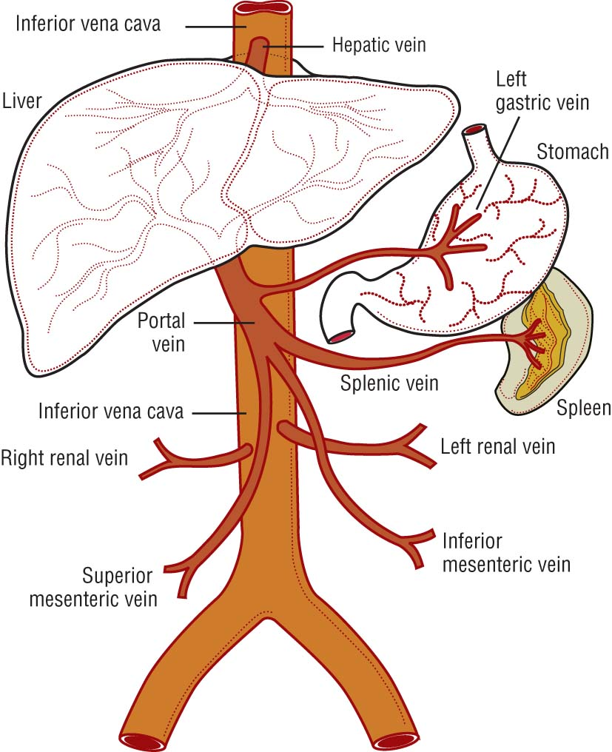
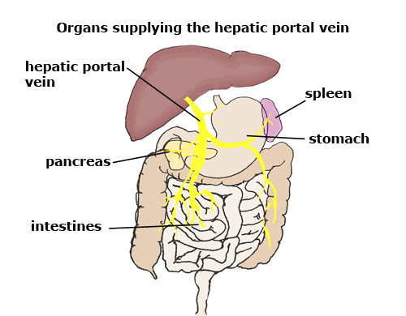
Cirrhosis – End Stage Liver Disease (ESLD)
Portal blood:
Mesenteric
Gastric
Splenic
Pancreatic

Slide 2
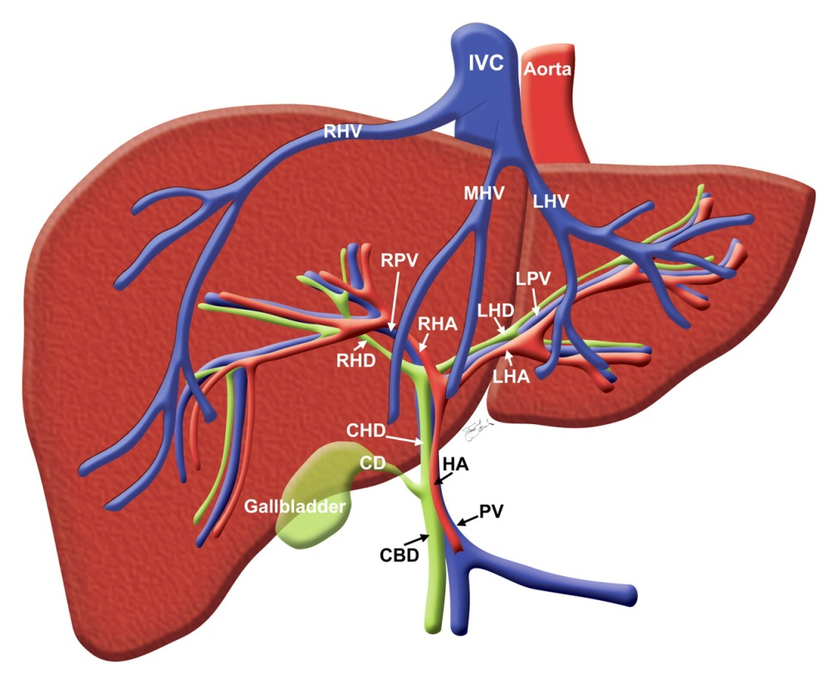
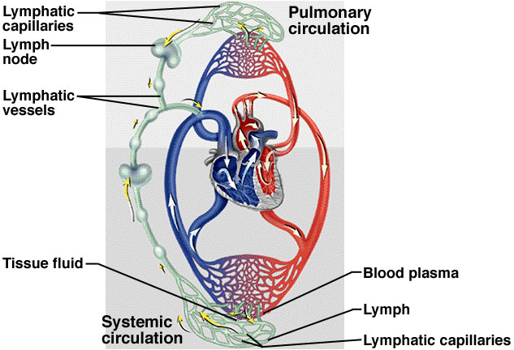
Portal “triad”:
Portal vein/hepatic artery
Bile duct
Lymphatic / nerve tissue

Slide 3
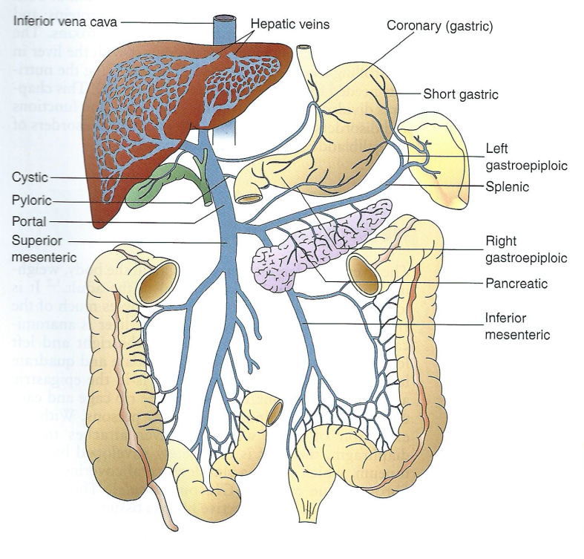
HEART
Vena Cava
Lobules in liver
Portal Vein

Slide 4
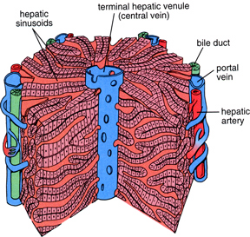
Central vein: collects filtered blood, empties into larger hepatic vein and inferior vena cava
Bile duct: collects bile to store in gall bladder
Portal vein: entry of deoxygenated blood from spleen, intestine & stomach circulation
Hepatic artery: entry of oxygenated blood to the liver from heart

Slide 5
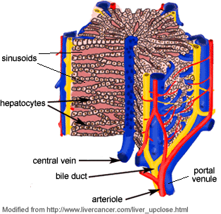
Sinusoidal spaces lined by hepatocytes
Hepatocytes arranged in plates that are one cell thick
Filtration occurs as blood enters the lobule and passes through the sinusoidal spaces lined with hepatocytes

Slide 6
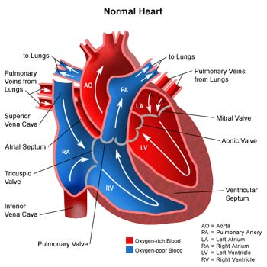
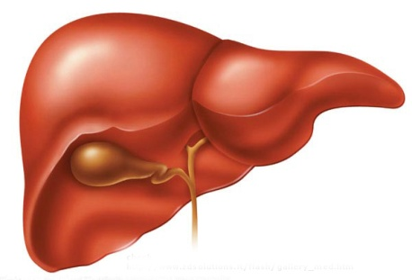
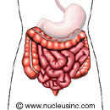
Summary of Hepatic Blood Flow
Inferior vena cava
Aorta
Hepatic artery
Hepatic vein
Liver
Arteries to digestive tract
Portal vein
Stomach, Intestine, and Spleen

Slide 7
Hepatocyte Functions
Hepatic Parenchyma
Hepatocytes close to portal triad:
Most O2 saturation capacity
High levels of glutathione, glucagon synthesis
Site of detoxification (Phase I & II)
Stellate cells (store vit A, liver fibrosis in response to liver damage
Functions of Liver:
Conjugation of bilirubin
Synthesis &/or storage of:
Albumin
Clotting factor
Glucose, cholesterol, transport protein
Metabolism of fats, carbs, proteins, drugs
5 major functions of the liver:
Conjugate bilirubin
Synthesize albumin
Synthesize clotting factors
Storage, synthesis & use of nutrients
Metabolism

Slide 8
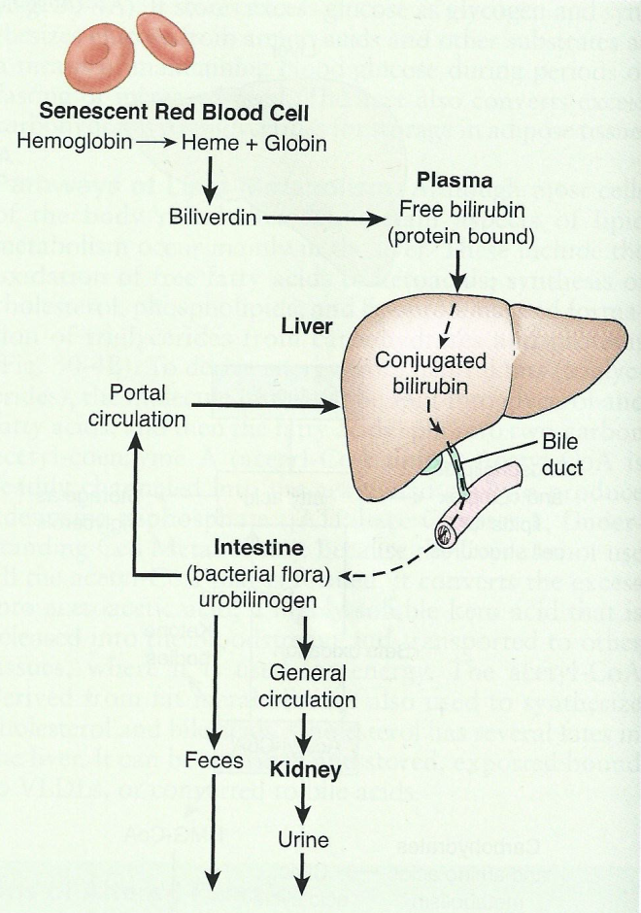
The Bilirubins
http://highered.mcgraw-hill.com/sites/0072495855/student_view0/chapter21/animation__hemoglobin_breakdown.html
Can also be reabsorbed back to liver, or
Can be reabsorbed from intestine to blood and kidney
Chronic liver disease:
High bilirubin levels
Acute liver injury:
High Hepatic enzyme levels

Slide 9
Metabolism in Liver
Phase I Metabolism
Utilizes CYP450 enzymes
Oxidation, reduction, hydrolysis
Significantly altered by cirrhosis/ESLD
Phase II Metabolism
Conjugation
Glucuronidation
Sulfation
Generally not significantly altered by cirrhosis/ESLD
Synthesizing Functions in Liver
Synthesis/Excretion
Glucose
Cholesterol
Transport/carrier proteins
Ammonia → urea
Albumin
Clotting Factors
Detoxification
Storage
Glycogen
Bilirubin/Bile
Vitamins A, D, B12
Folic acid
Bacteria-fighting cells
Utilization
Protein metabolism
Carbohydrate metabolism
Lipid metabolism

Slide 10
CIRRHOSIS, ESLD
Alcoholic liver disease (ALD)
Spectrum from simple steatosis to cirrhosis
Steatosis
Fatty deposits
Cirrhosis
Fibrotic changes
End-stage liver disease →death unless transplant

Slide 11
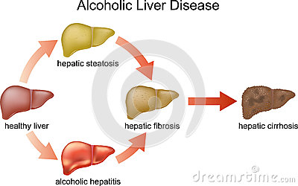
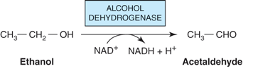
Formation of reactive oxygen species … damage hepatocytes
↑ NADH/NAD⁺ ratio …. ↓ oxidation of fatty acids … ↑ production of triglycerides / microvesicular fat

Slide 12
CIRRHOSIS
Definition
Fibrosis of hepatic parenchyma resulting in
Altered hepatic function
Restricted venous outflow
Portal hypertension
Also results in
An overall vasodilated state
Activation of RAA
Altered hepatic synthetic function
Development of complications (i.e., ascites)
Drugs causing ACUTE liver failure: Acetaminophen, Niacin, Kava-kava

Slide 13
CIRRHOSIS
Fat deposits in hepatocytes
No functional impairment
Reversible
Formation of collagen/scar
+ functional impairment
Not Reversible
Inflammation, Immune Rx, Necrosis, Death of hepatocytes
+/- functional impairment
Less Reversible

Slide 14
CIRRHOSIS – Compensated vs Decompensated
Compensated
Decompensated
Liver is scarred, but body still functions fairly well
Few or no symptoms
Body NOT functioning well
Worsening minor symptoms
Edema on extremities
Ascites
Portal hypertension
Jaundice
Itching
Palmar erythema
Gynecomastia/testicular atrophy
Bleeding/bruising

Slide 15
Continuum of Cirrhosis
Patho-Anatomy
Normal liver tissue plus hepatotoxins →
Inflammation, abnormal collagen secretion →
Fibrosis (protein buildup) in attempt to heal →
Collagen builds up →
Bridging cirrhosis →
Frank hepatic cirrhosis →
Chronic liver disease
Patho-Physiology
Replacement of normal hepatic parenchyma by fibrotic tissue →
Resistance to blood flow leads to portal hypertension →
Develop varices and ascites →
Hepatocyte loss, intrahepatic blood shunting →
Diminished metabolic/synthetic function →
Hepatic encephalopathy and coagulopathy

Slide 16
CIRRHOSIS – Lab Data
Injury – Short term/Acute
Function – Long-term/chronic
Damage to hepatocytes
Measured by intracellular enzymes
↑AST > 3x ULN
↑ALT > 3x ULN
AST: ALT ratio > 2:1
↑ALP (+/- ↑ GGT)
VALUES CAN BE MUCH HIGHER
Ability of liver to perform normal functions
Measured by
↑ INR
↓ Albumin
↑ Unconjugated bilirubin
↑ Total bilirubin

Slide 17
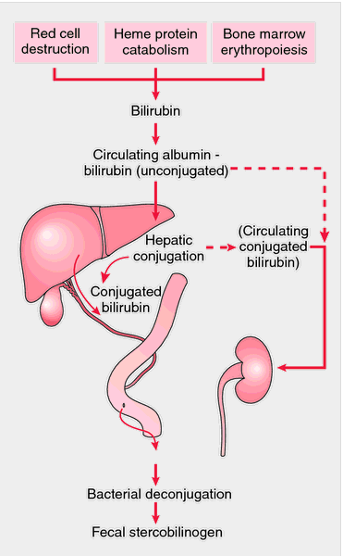
Causes of Elevated Bilirubin
↑ RBC destruction (hemolytic anemia)
↓ Liver function … ↓ conjugation
Blockage/damage of biliary canal (gall stone, tumor)

Slide 18
Causes of Elevated Conjugated Bilirubin
↑ Conjugated Bilirubin + ↑ AST/ALT = Significant liver injury
↑ Conjugated Bilirubin + ↑ ALP = Cholestatic disease
↑ Unconjugated Bilirubin = Possible Hemolysis
Other lab changes:
Coagulation studies
Albumin
Child-Pugh Scoring vs Model for End-Stage LD (MELD)
MELD uses:
Bilirubin
INR
SCr
Prioritize transplant candidates
Range of pts: 6 - 40
Child-Pugh uses:
Total Bilirubin
PT INR
Serum albumin
Ascites
Hepatic encephalopathy
Prioritize transplant candidates
Range of class: A, B, C
Grade C: survival 45% in 1 yr, 35% in 2 yrs

Slide 19
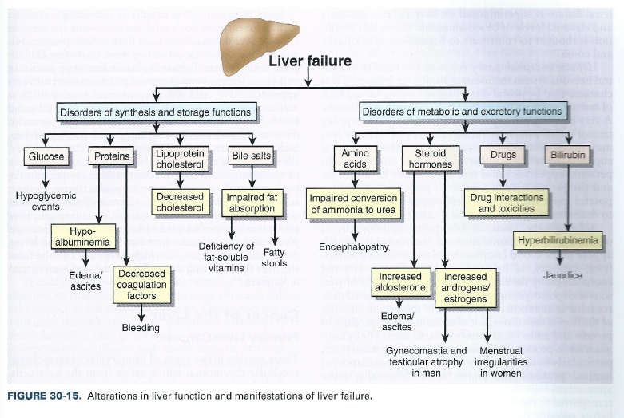
MAJOR SEQUELAE OF CIRRHOSIS/ESLD

Slide 20
MAJOR SEQUELAE OF CIRRHOSIS/ESLD
Portal hypertension
Gastroesophageal varices
Ascites
Spontaneous bacterial peritonitis
Hepatorenal syndrome
Hepatic encephalopathy
Coagulation defects

Slide 21
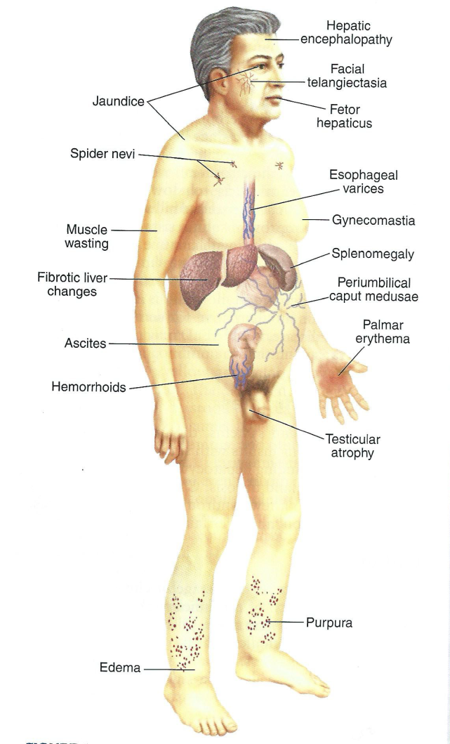
Other Sequelae

Slide 22
Flow of ESLD / Cirrhosis
Portal Hypertension
Poor Liver Function
Low Albumin
Varices Formation
Ascites
Chronic Varices
Altered Metabolism & Elimination
Hepatic Encephalopathy
Bleeding Varices
Spontaneous Bacterial Peritonitis (SBP)
Coagulation Disorders
A pt has to have ascites before having SBP … ascites does not imply SBP

Slide 23
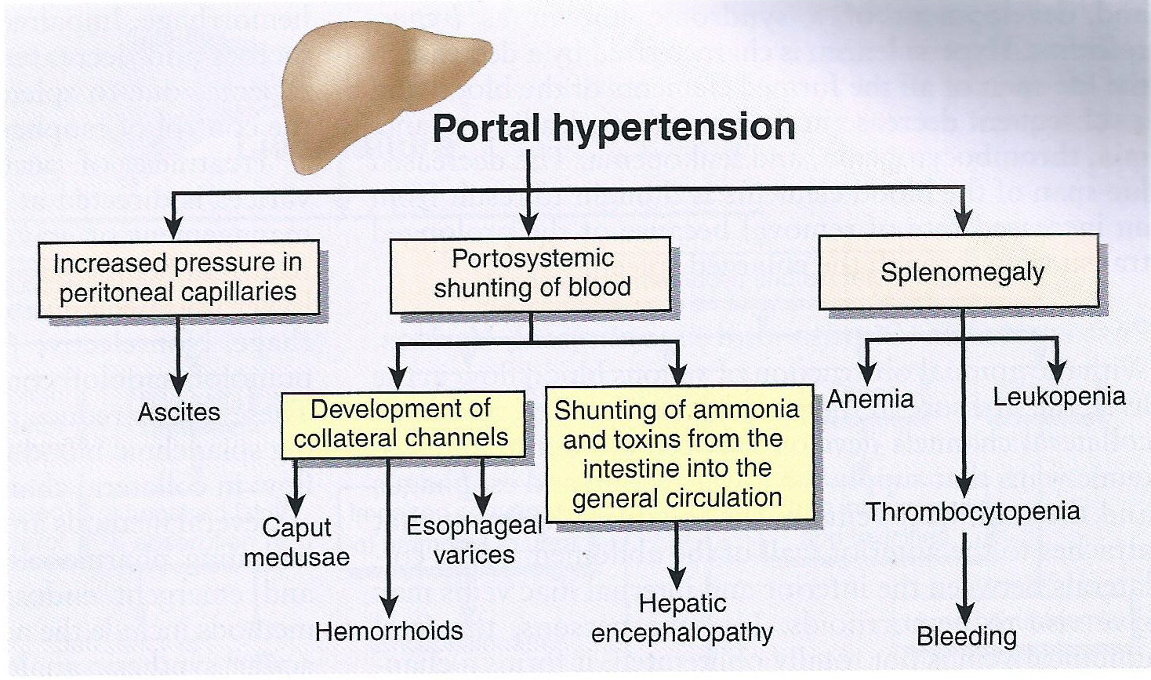
Portal Hypertension
Blood pressure gradient > 5 mm Hg
8-10 mm Hg … varices
> 12 mm Hg … active bleeding
Three types of portal hypertension:
PRE-hepatic … splenomegaly, thrombosis of portal vein
INTRA-hepatic … cirrhosis
POST-hepatic … right sided heart failure

Slide 24
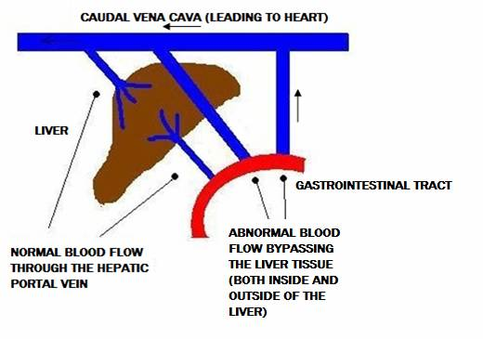
Ammonia & toxin into general circulation causing hepatic encephalopathy

Slide 25
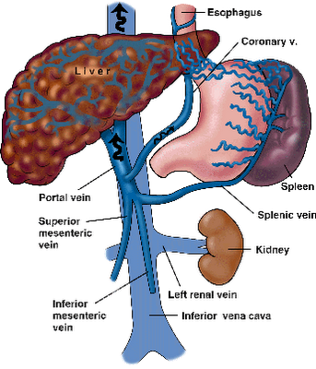
Pathophysiology of Portal Hypertension
Resistance to portal blood flow
Inflammation, fibrosis scarring of liver tissue
Vasoconstriction within liver (↓ nitric oxide)
Increased portal blood flow
Vasodilation of splanchnic (portal) vessels
Collateral vessels form away/around the liver
Formation of gastroesophageal varices
Gastroesophageal Varices can develop in the gastric, esophageal, or rectal regions

Slide 26
Cirrhosis
Reduced blood flow through liver
Portal Hypertension
>10 mmHg
Pooling of Blood
Vasodilation of splanchnic, mesentery, abdominal veins
Collaterals
Collaterals
Formation, enlargement & engorgement of collateral blood vessels
Gastroesophageal Varices

Slide 27
G/E Varices - Management
1⁰ prophylaxis: keep portal pressure < 12 mm Hg & prevent 1st bleeding
Treat any acute bleeding
2⁰ prophylaxis: prevent a second bleeding
1⁰ Prophylaxis:
Non-selective BBs (propranolol, nadolol) to block B2 receptors instead of B1 in the heart
Tx of acute bleeding:
Hematemesis/melena: Acute esophageal variceal hemorrhage is a medical emergency
Octreotide IV (long acting synthetic analog of somatostatin) – vasoconstriction of splanchnic vasculature
Endoscopic band ligation (EBL) – most effective
Supportive:
Fluid resuscitation
Correct coagulopathy (vit K, platelets, FFP)
Prevent infection (antibiotics)
2⁰ Prophylaxis:
Non-selective BBs + EBL procedure
Supportive:
- Fluid resuscitation
- Correct coagulopathy
- Prevent infection
Propranolol 20 mg PO BID; max 80 mg BID
Nadolol 40 mg PO Daily; max of 160 mg daily

Slide 28
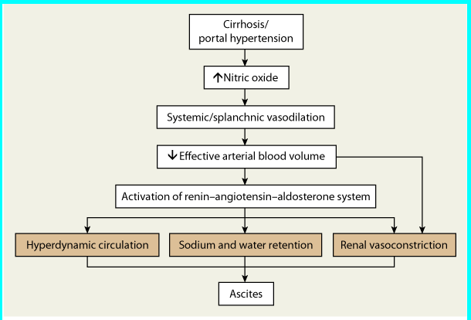
Ascites – Mechanism
Accumulation of fluid in peritoneal cavity
Hyperdynamic circulation is abnormally increased circulatory volume
Nitric oxide: vasodilator

Slide 29
Ascites - Assessment
Serum-Ascites Albumin Gradient (SAAG):
SAAG = Serum Alb - Ascites Alb ≥ 1.1 g/dl … portal hypertension … rule out spontaneous bacterial peritonitis
Baseline measurements:
Renal functions (SCr, BUN, CrCl/GFR)
Electrolytes (K, Mg, Na)
Blood pressure
Ascites - Management
USE TOGETHER – single use of either agent is not as effective
Spironolactone : Furosemide at 100 : 40 mg ratio
Supportive
Non-pharmacological (no alcohol, low Na, fluid restriction)
Paracentesis
Albumin only if > 5 L removed from paracentesis

Slide 30
Spontaneous Bacterial Peritonitis
Risk Factors:
Ascitic fluid protein concentrion < 1 g/dL
Variceal bleeding
History of SBP
Signs & Sx of Infections:
↑ WBC, fever
Abdominal pain, N/V
New-onset encephalopathy, GI bleeding, renal dysfunction
Diagnosis:
↑ polymorphonuclear counts > 250 / mm3
Culture: E. coli, Klebsiella pneumonia, Strep pneumonia, enterococci
Treatment: 5 days min for negative culture – 10 days for positive culture
Tx immediately after ascites fluid is taken for diagnosis … do not wait for culture
Empiric antibiotic Tx
3rd generation cephalosporins (Cefotaxime, Ceftriaxone)
Fluoroquinolone (Ofloxacin, Ciprofloxacin)
Supportive:
Albumin IV infusion … 1.5 g/kg x 1 dose (day 1) … 1 g/kg x 1 dose (day 3)
No more than 100 g of albumin
Long-Term Prophylaxis
Norfloxacin or Ciprofloxacin
TMP-Sulfa DS
Lab requires albumin IV:
Bilirubin > 4
SCr > 1
BUN > 30

Slide 31
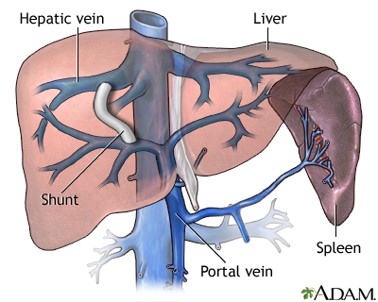
Hepatorenal Syndrome
Renal failure in terminal liver disease:
Progressive azotemia
↑ SCr
Oliguria (↓ urine output)
Hepatic Encephalopathy
Ammonium in GI … Portal system … Converted to urea (liver) … General Circulation … Excretion
Liver Disease
Precipitating factors
Oral protein load
GI bleed
Use of sedatives (benzodiazepines, opiates)
TIPS, shunting procedures
Infection
Progression of cirrhosis
Transjugular intrahepatic portosystemic shunt

Slide 32
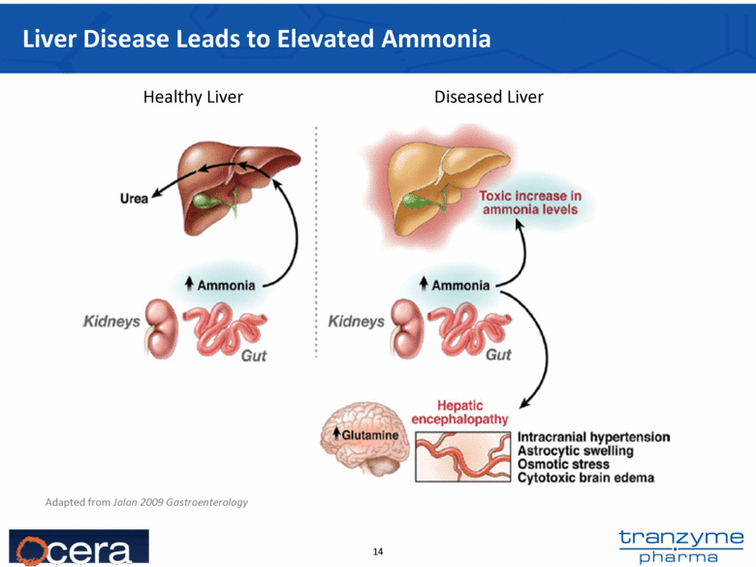

Slide 33
Hepatic Encephalopathy
Clinical features:
Altered mental status
Mood change
Lethargy
Dementia
Sleep disturbance
Speech disturbances
Memory deficits
Physical exam:
Asterixis (“liver flap”)
Ataxia
Coma
Lab values:
Ammonia levels poorly correlate with clinical response
HE Treatment
Lactulose – non-absorbable disaccharide
Converted to fatty acid by bacteria … converts NH₃ to NH₄⁺ non-absorbable
Laxative effect to eliminate NH3
Rifaximin – non-absorbable intestinal antibiotic
Mono- or combo-Tx with lactulose
Miscellaneous Drugs
Neomycin – not 1st line, use in lactulose-refractory cases (aminoglycoside with ototoxicity, nephrotoxicity, superinfection)
Metronidazole – not use when neurotoxicity
Asterixis (also called the flapping tremor, or liver flap) is a tremor of the hand when the wrist is extended
Ataxia: lack of voluntary coordination of muscle movements

